Slide 1

Machine Learning Crime Prediction
Stefanie Huckleberry
Sherry Jystad
Xinyue Shi

Slide 2

Project Goals
Use AI/ML to predict crime type, victim age, or crime location based on features such as, weather, seasons, time of day, type of dwelling and population.

Slide 3

Data Cleaning and Preprocessing
Original Dataset = 1.9 million rows!
LESSON LEARNED: Too many distinct categories within a feature will not produce good results.
The LA Crime dataset contained categories/features that were too granular (i.e., there were 129 distinct crime codes and 265 distinct premise codes). We used Excel to group “like” categories and reduce the number of codes.
Python Pandas was also used to further transform the data into what we felt would be more understandable to a machine learning model.
Time Occurred (24 hours) ⇒ 4 categories (Morning/Afternoon/Evening/Night)
Crime Codes ⇒ 129 down to 11, even further whittled down to Felony, Misdemeanor, Infraction
Premise Codes ⇒ 265 down to 24

Slide 4
Technologies used to solve, analyze and visualize in crime predictions
Machine Learning libraries from Sci-Kit Learn
Linear Regression
Logistic Regression
Classification and Regression Trees – Decision Trees
K-Nearest Neighbors
Random Forest
Python Pandas
Matplotlib
SQLite Database
Tableau
Crime prediction requires a supervised classification ML model

Slide 5
Top 10 Types of Crime
Type | Description | Total
420 | THEFT FROM MOTOR VEHICLE - PETTY ($950 & UNDER) | 6942
210 | ROBBERY | 7344
230 | ASSAULT WITH DEADLY WEAPON, AGGRAVATED ASSAULT | 8644
626 | INTIMATE PARTNER - SIMPLE ASSAULT | 8903
740 | VANDALISM - FELONY ($400 & OVER, ALL CHURCH VANDALISMS) | 10077
310 | BURGLARY | 10286
510 | VEHICLE - STOLEN | 11412
440 | THEFT PLAIN - PETTY ($950 & UNDER) | 13046
330 | BURGLARY FROM VEHICLE | 14673
624 | BATTERY - SIMPLE ASSAULT | 16820

Slide 6
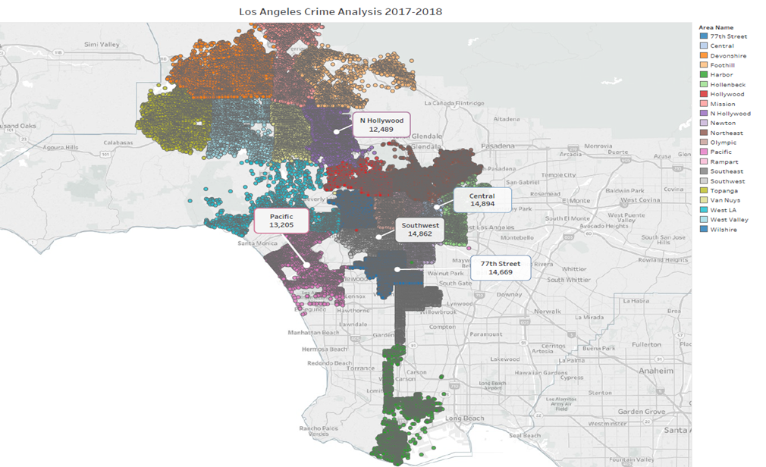
Top 5 crime areas are highlighted

Slide 7
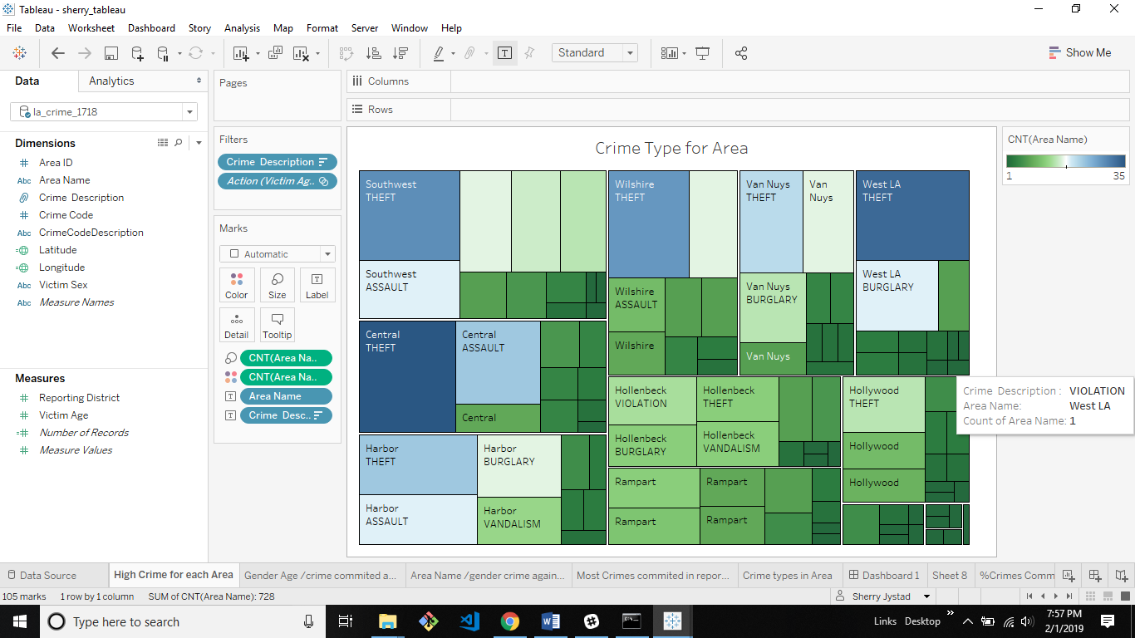

Slide 8
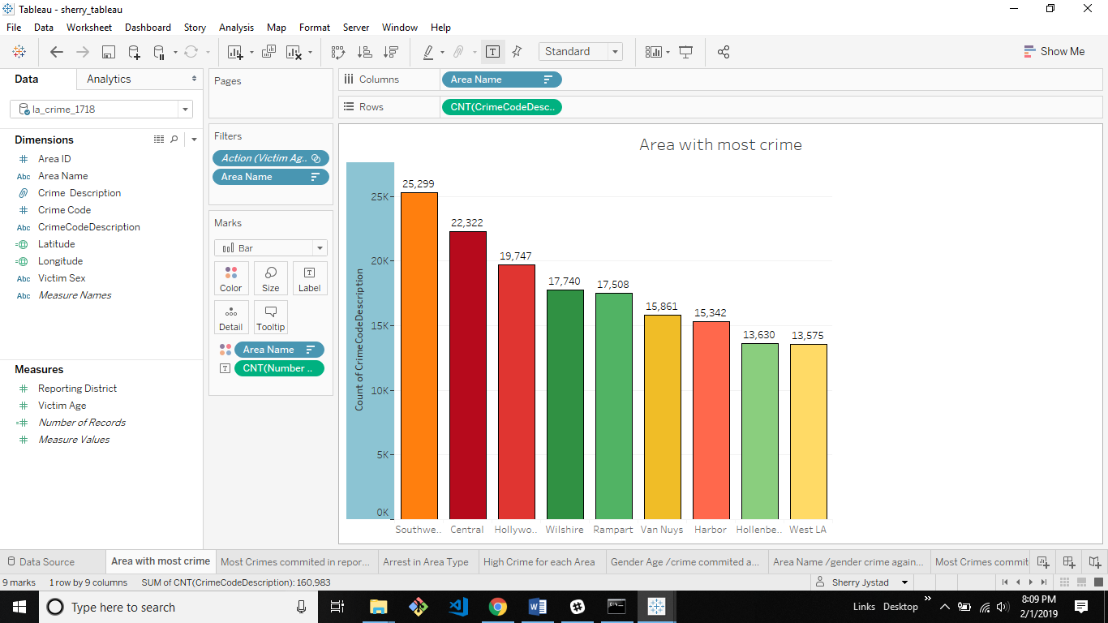

Slide 9
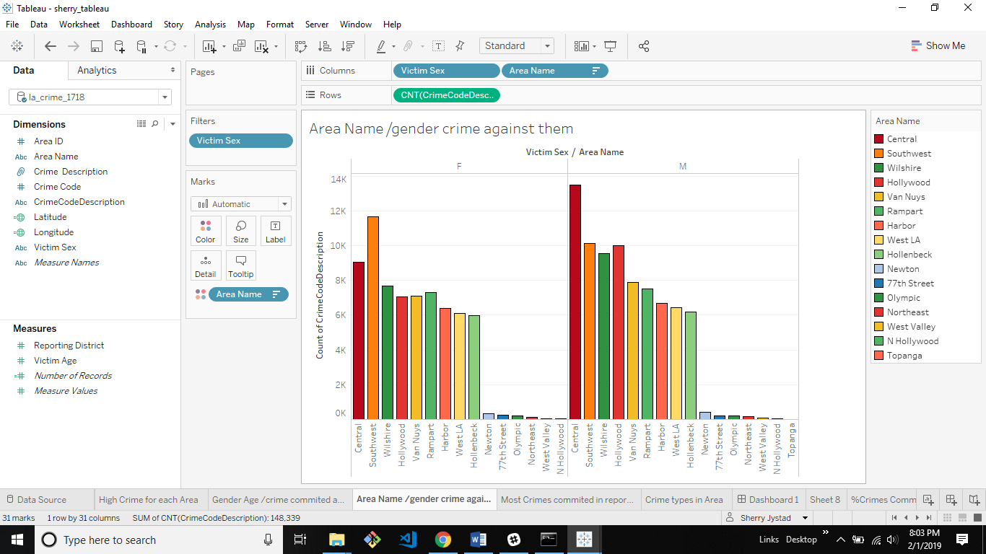

Slide 10
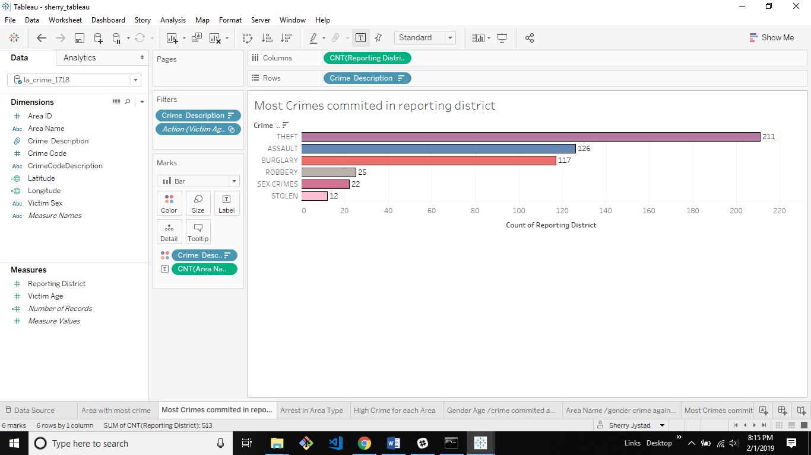

Slide 11
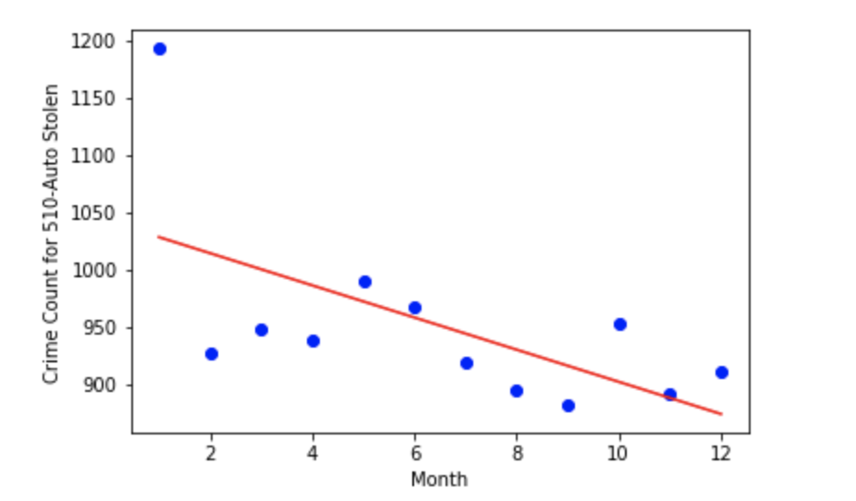

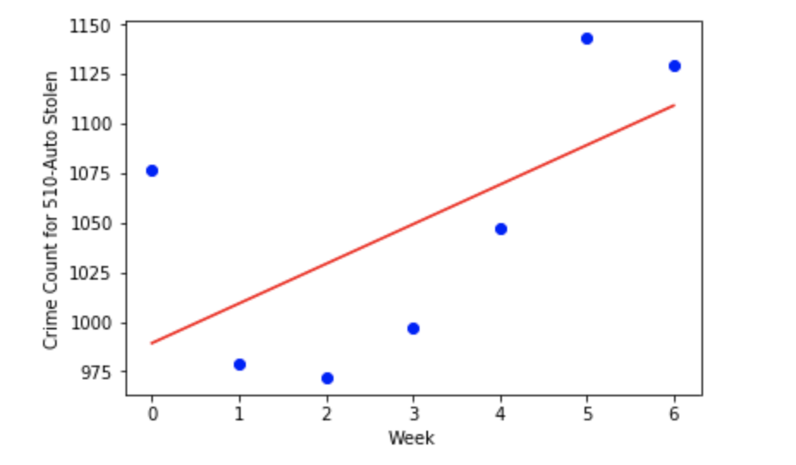
Linear Regression and Auto Theft
We used Linear Regression to determine whether the month of the year can predict Auto Theft.

Slide 12
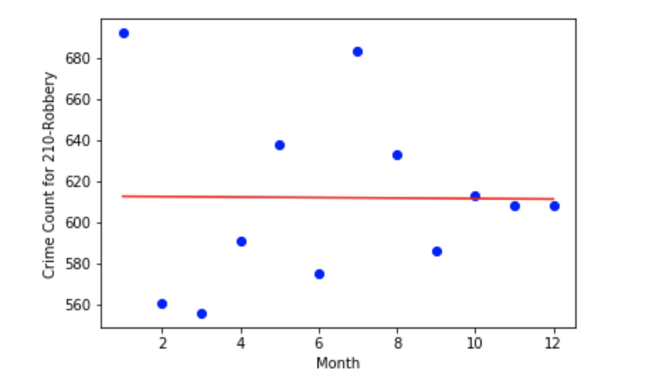
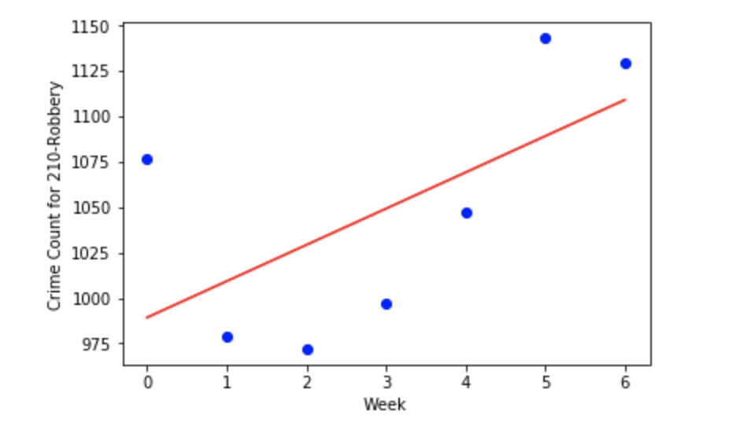

Linear Regression and Robbery
We also used Linear Regression to determine whether the month and day of the week can predict Robbery.

Slide 13
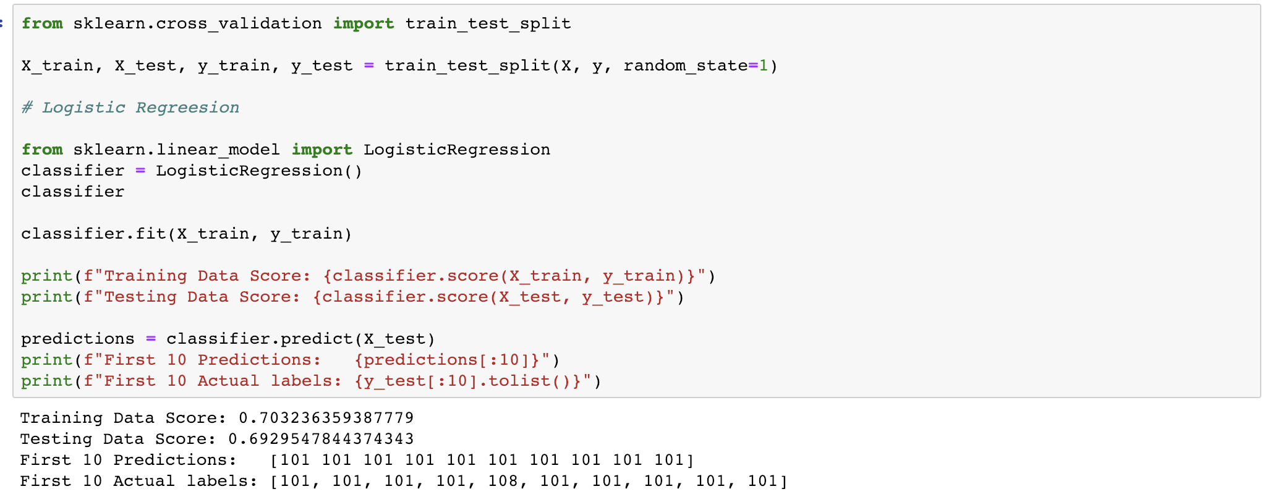
Logistic Regression
This logistic regression concentrates on Crime Code 510—Vehicle Stolen. I used Premise code (dwelling) as a predictor.
Prediction result: Premise code 101: Street, 108: Parking Lot

Slide 14
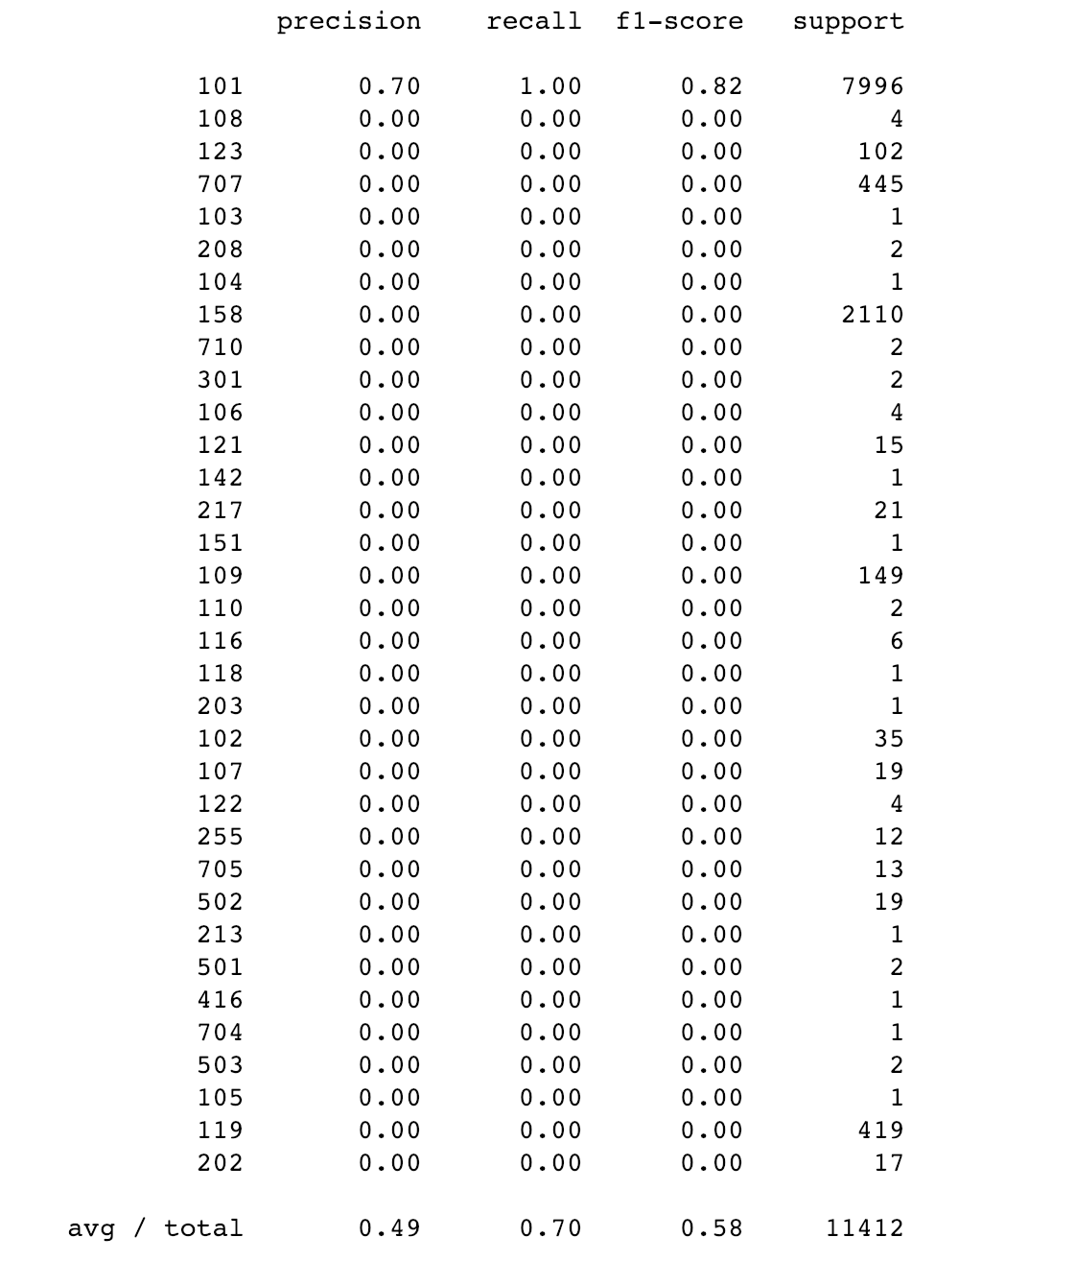
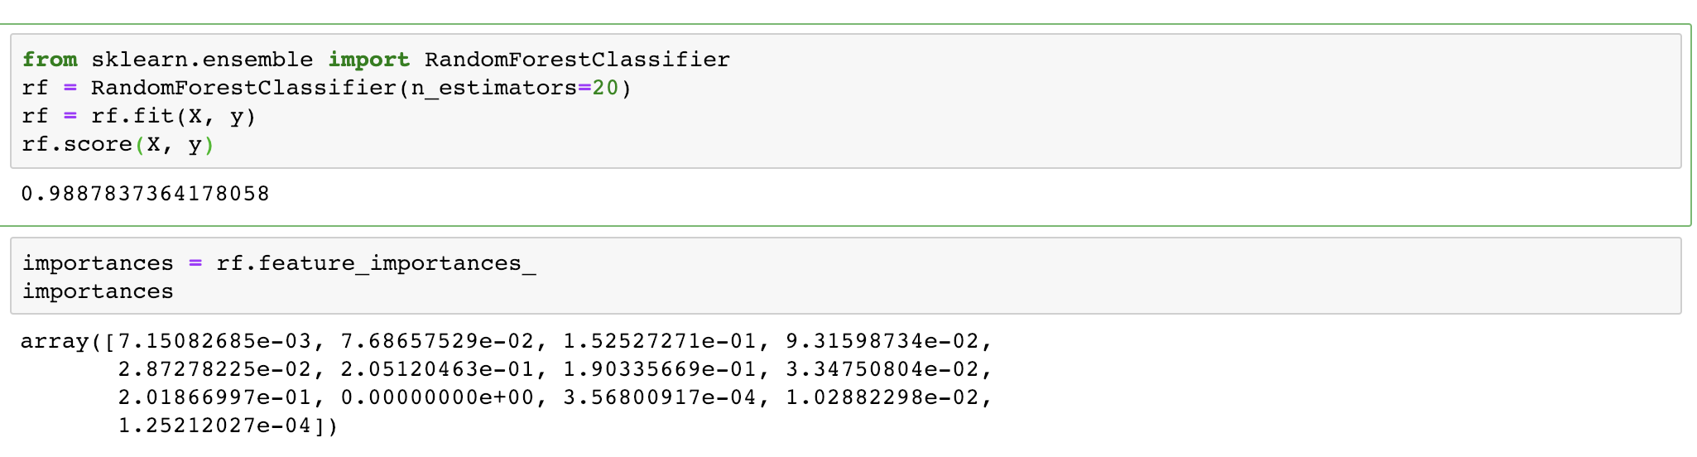
Random Forest & Grid Search
This Random Forest helps to classify which feature has more influence on Crime Code 510—Vehicle Stolen.
Feature importance result:

Slide 15
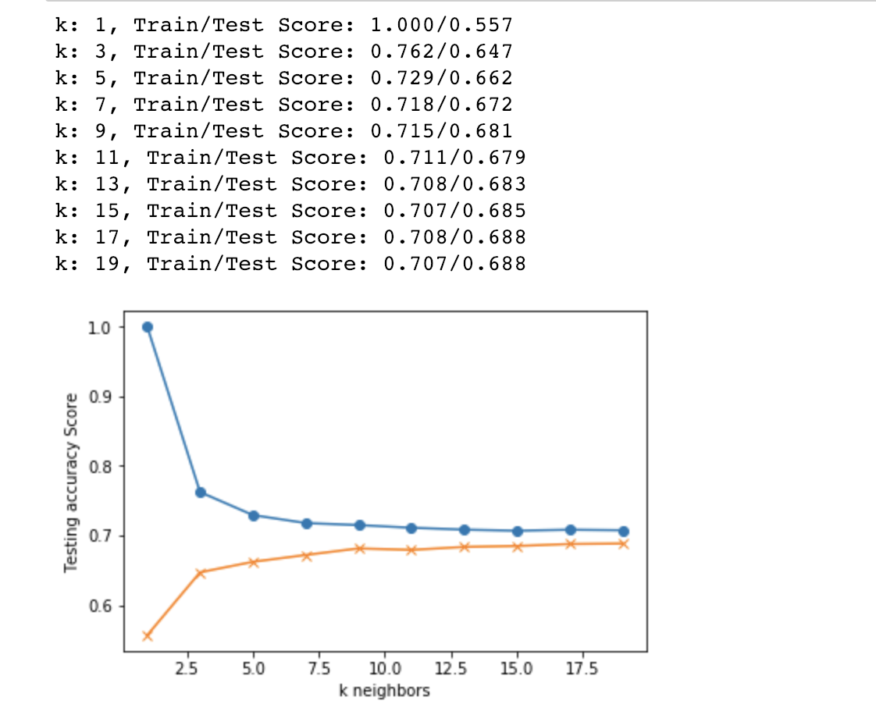
k-nearest neighbors (k-NN)
We used k-NN to support the prediction. From the graph, when K = 13, it gets stable.
k-NN test score was 0.6929547844374343
k-NN train score was 0.703236359387779

Slide 16
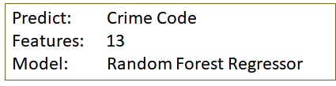
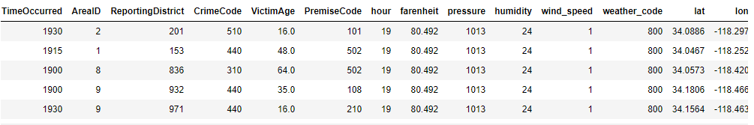

Random Forest (no encoding)
Crime Code | Description | Average MAPE
510 | Stolen Vehicle | 10.77%
440 | Petty Theft | 11.28%
624 | Battery-Simple Assault | 22.48%
354 | Identity Theft | 29.52%
310 | Burglary | 45.93%
Lowest Margin of Error:
Stolen Car/Petty Theft

Slide 17
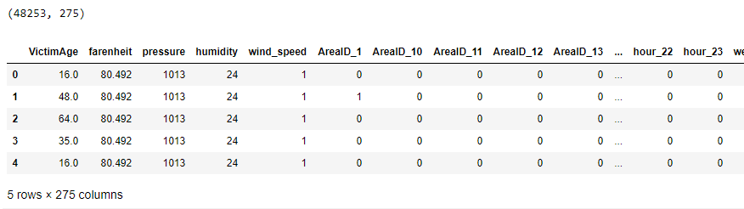
Random Forest (one-hot encoding)
Model: Random Forest Classifier & Random Forest Regressor
Features: after one-hot encoding, feature columns increased to 275
Results: TERRIBLE (.06% and 33%)
Conclusions: After encoding the string-based classifiers, Random Forest Classifier gave a score of .06% and Random Forest Regressor gave a score of 33%. This proves that our initial assumptions were wrong because the model was weighting the features based on their numeric codes.

Slide 18
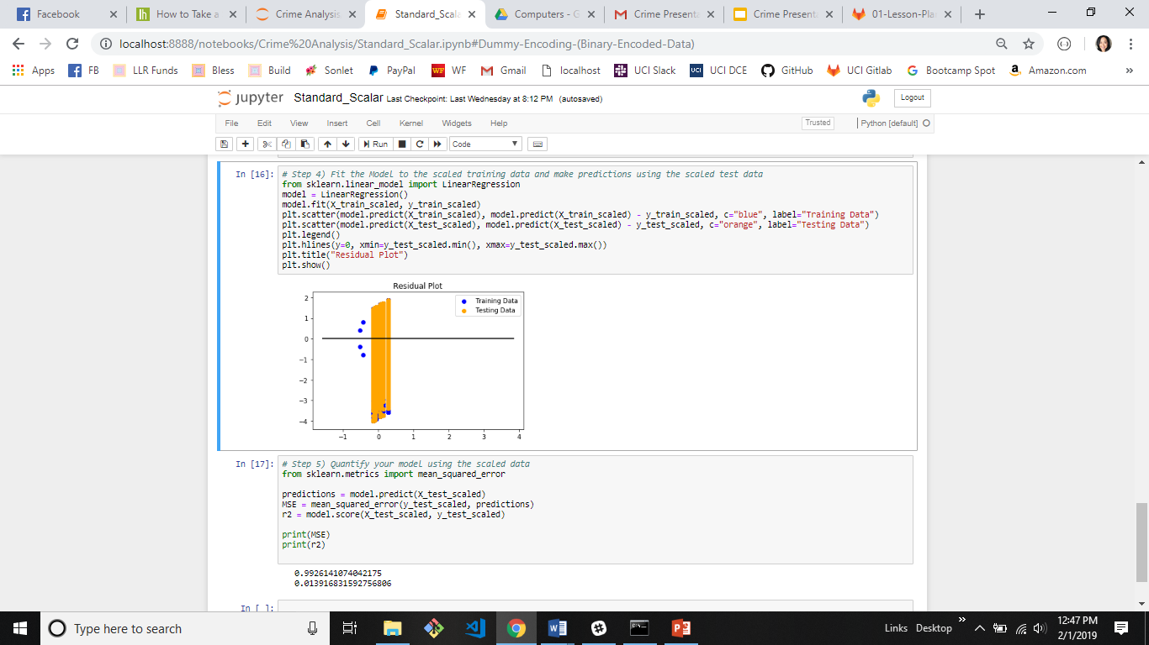
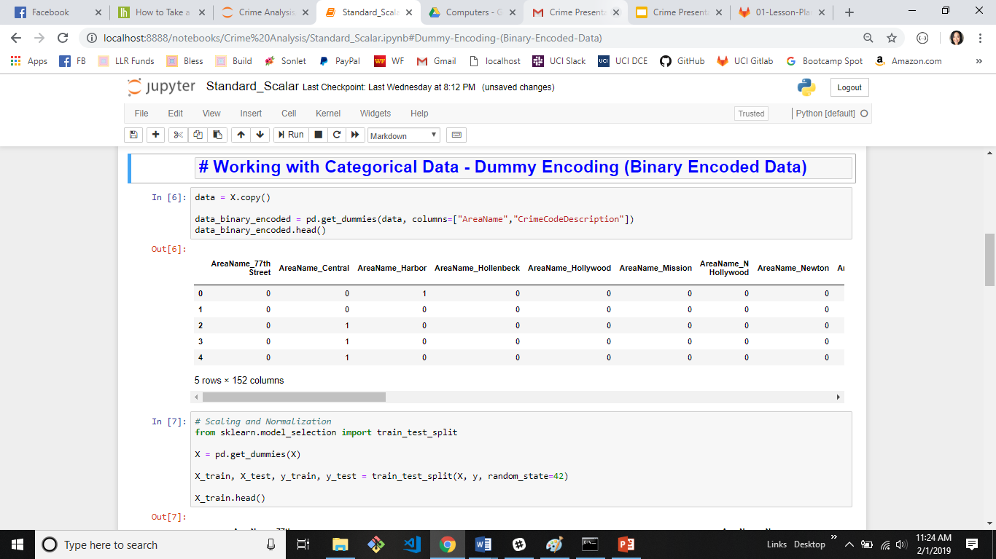
Logistic Regression
Data was binary encoded for AreaName and Crime Code Description. The MSE score needs to be as close to 0 and the R2 score needs to be close to 1. Thus this model is not good for the Crime Data set.

Slide 19

Random Forest
A random forest is a meta estimator that fits a number of decision tree classifiers on various sub-samples of the dataset and uses averaging to improve the predictive accuracy and control over-fitting.
Convert dataset to string. Don’t want to weigh the Area Name, Age or Code Description
One hot-encode crimeset. Label is VictimAge_17. Feature is the rest of the dataset.
Using Skicit-learn to split data into training and testing sets.
Predict the historical averages using baseline predictions.
Import the RandomForestRegressor, then train the model.

Slide 20


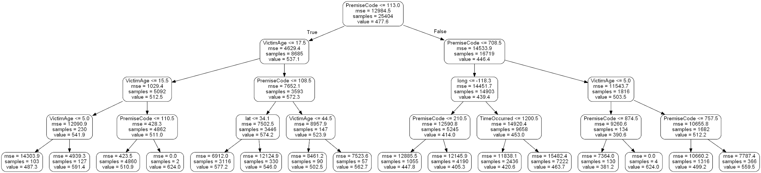
Results:
Average baseline error: 30.95
Mean Absolute Error: 11.48 degrees
Accuracy: 63.13%
Random Forest Decision Tree Depth - 4

Slide 21
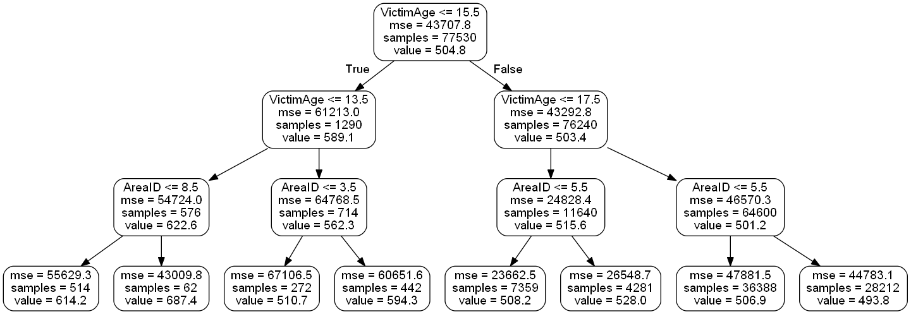
Random Forest Decision Tree
depth = 3

Slide 22
Machine Learning Analysis & Results
Target | Features | Model | Score | Findings
Crime Code | Time Occurred, Area ID, Reporting District, VictimAge, Premise Code, weather features | RandomForestRegressor | 83.3% | Crime codes are represented as numbers, but they’re really just classifications. This score might not be correct because all of the classifiers should be one-hot encoded.
Crime Code | Month, day of week | Linear Regression |  | Weight coefficients: [[-0.11888112]] y-axis intercept: [612.77272727]
Crime Code | Year, month, day, dayofweek, quarter, DRNumber, Time Occurred, AreaID, Reporting Disrict, CrimeCode, MoCodes, VictimAge, Premise Code, WeaponUsedCode | RandomForestClassifier | 98.92% | Use RandomForest to classify which column is more influence to y. The highest importance number is the most relative effector. Use classifier in each individual crime code. If combine together, it will lower the score.
Crime Code | Premise Code | Grid Search | 70% | It is the only successful model for this specific crime code 510. I tried for top 10 crime code and they all failed. The score is below 30%
Crime Code | Premise | kNN | 70% | The only Premise code has the score is 101-street, which is the predict location happened for vehicle stolen. The other crime type also failed, the score is below 30%
Victim Age | Population, Crime Classification, Weather | DecisionTreeClassifier | 16.5% | This was a bust.
Crime Classification | Time Occurred, AreaID, Reporting District, Crime Code, Victim Age, Premise Code, Weather features | LogisticRegression | 43% | Not a very good result. Possibly too many features, or the features are just not predictive.
Crime Classification | Month, Time of Day, Premise, Weather Type, Location | RandomForestClassifier | 51% | Not a very good result. The weather is not predictive, nor is the location in the city.

Slide 23
VictimAge | AreaName, CrimeCodeDescription | Linear Regression | MSE – 1.01 R2 - .0056 | Data was binary encoded for AreaName and Crime Code Description. The MSE score needs to be as close to 0 and the R2 score needs to be close to 1. Thus this model is not good for the Crime Data set.
VictimAge | AreaName, CrimeCodeDescription | LASSO Model | MSE – 1.012 R2 - .00539 | Data was binary encoded for AreaName and Crime Code Description. The MSE score needs to be as close to 0 and the R2 score needs to be close to 1. Thus this model is not good for the Crime Data set.
VictimAge | AreaName, CrimeCodeDescription | Ridge Model | MSE – 1.0001 R2 - .005597 | Data was binary encoded for AreaName and Crime Code Description. The MSE score needs to be as close to 0 and the R2 score needs to be close to 1. Thus this model is not good for the Crime Data set.
VictimAge | AreaName, CrimeCodeDescription | ElasticNet | MSE – 1.0010 R2 - .005536 | Data was binary encoded for AreaName and Crime Code Description. The MSE score needs to be as close to 0 and the R2 score needs to be close to 1. Thus this model is not good for the Crime Data set.
VictimAge | AreaName, CrimeCodeDescription | Random Forest Regressor | Average baseline error: 30.95 Mean Absolute Error: 11.48 degrees Accuracy: 63.13% | This model seems to the best to use for analyzing model. Data is not one hot encoded. It’s possible the CrimeCode, AreaName and VictimAge was treated as integer instead of a string.

Slide 24



Data Sources
Crime Data from 2010 to Present | Los Angeles - Open Data Portal
https://data.lacity.org/A-Safe-City/Crime-Data-from-2010-to-Present/y8tr-7khq
United States Census Bureau
https://www.census.gov/geo/reference/centersofpop.html
Open Weather Map
https://openweathermap.org/api

